Slide 1
Design Patterns
The Decorator Pattern
IT 426

Slide 2

Definition
Gang of four:
“Attach additional responsibilities to an object dynamically. Decorators provide a flexible alternative to sub-classing for extending functionality.”

Slide 3
Appropriate problems
Optional features
Dynamic updates
Problems requiring combinations of features to solve
File IO
Reading/writing to a file
byte-by-byte as text
line-by-line as text
as an object
Compressing a file
Encrypting a file
Zipping a file
Problems that require regular updates as part of a solution
GUI textbox widgets
Borders
Scrollbars
Multi-line
Rich text
Auto-complete
Password screening

Slide 4
GUI textbox widget
Creating classes likely to require rapid amounts of new features
Textbox
Bordered Textbox
ScrollableTextbox
Rich Textbox
Multiline Textbox
Scroll Border Textbox
Rich Border Textbox
Multi Border Textbox
Scroll Rich TextBox
Scroll Multi Textbox
Rich Multi TextBox
Notes:
How many classes would I have if I added HTML support feature?

Slide 5
GUI textbox widget
Textbox
isMultiline
border
richTextEnabled
hasScrollbars
Changing my design
Move optional functionality into one class
What about future changes?
Save feature?
HTML?
Cut-copy-paste?
Undo-redo?
What about the open-closed principle?

Slide 6
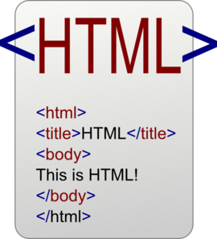
The decorator pattern
Create classes (“decorators”) that add (“decorate”) features to another Class (“subject”)
Here is a simpler problem
Generating HTML text
Font?
Color?
Link?
Border?

Slide 7
Decorator Pattern
Structural pattern
Participants
Subject
The object or module that requires dynamic features.
Decorator
A class that references and adds to the feature set or functionality of a subject class.

Slide 8
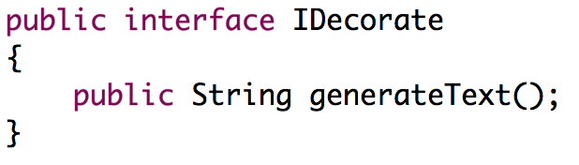
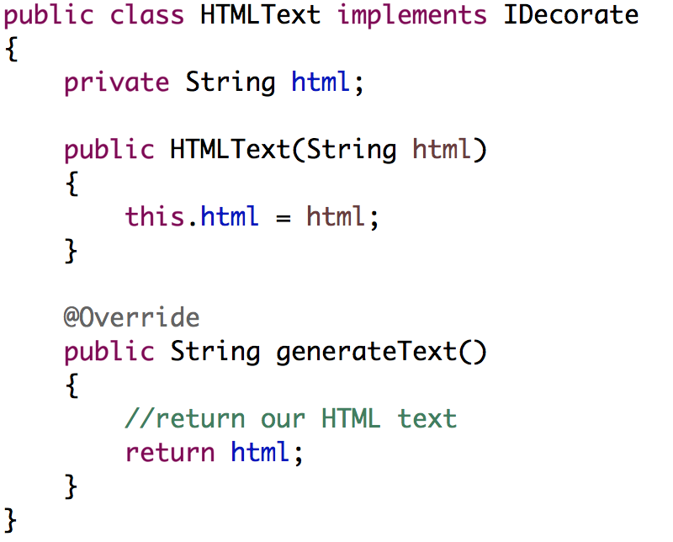
Step 1: the decorator interface
Create an interface with methods that represent functionality we wish to add to our “subject” class
The “subject” class should implement the interface

Slide 9
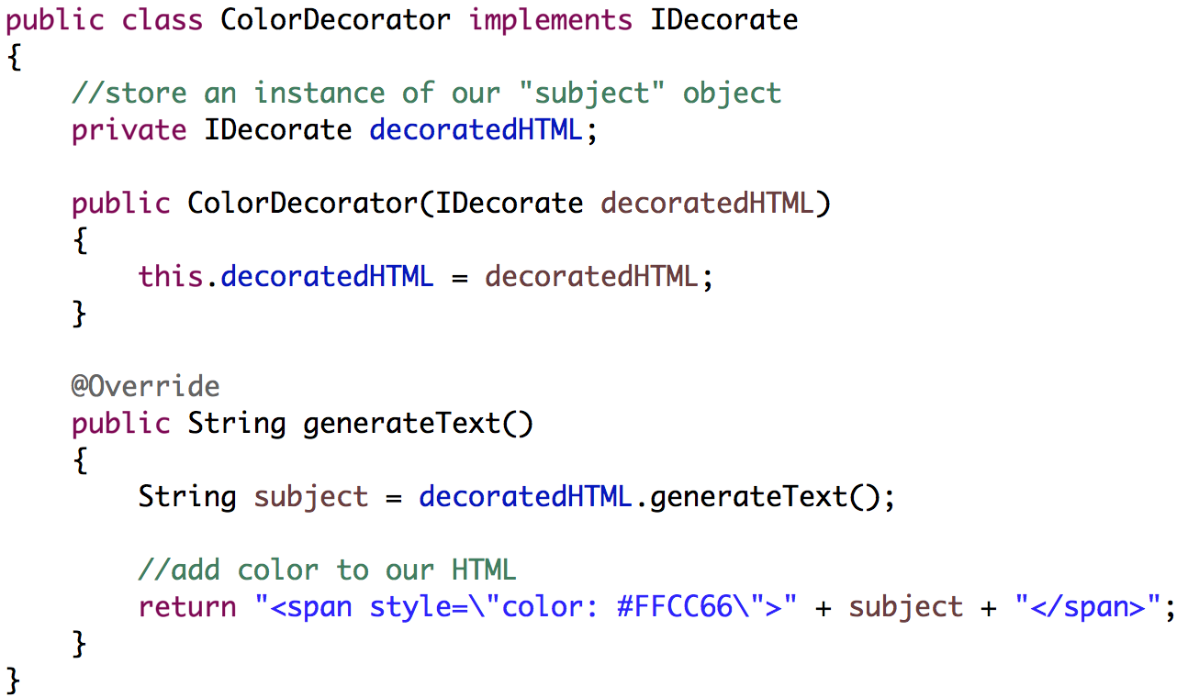
Step 2: decorator classes
Create concrete classes that use this interface
Each class will accept a source object to be decorated
The subject uses the same interface as a decorator

Slide 10
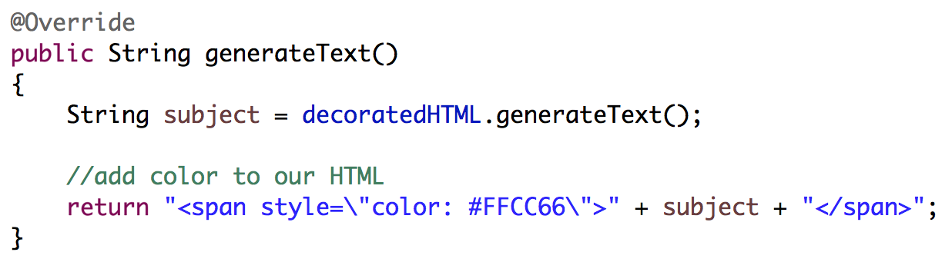
Step 3: implement interface
Each class is then responsible for adding functionality to the “decorated object”
You will need to call the interface methods on your “decorated object” before or after you decorate!

Slide 11
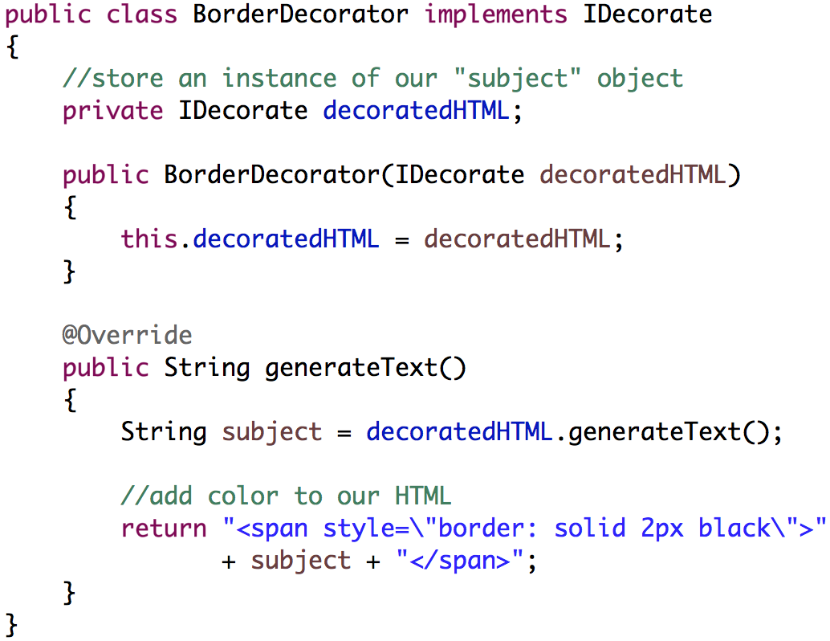
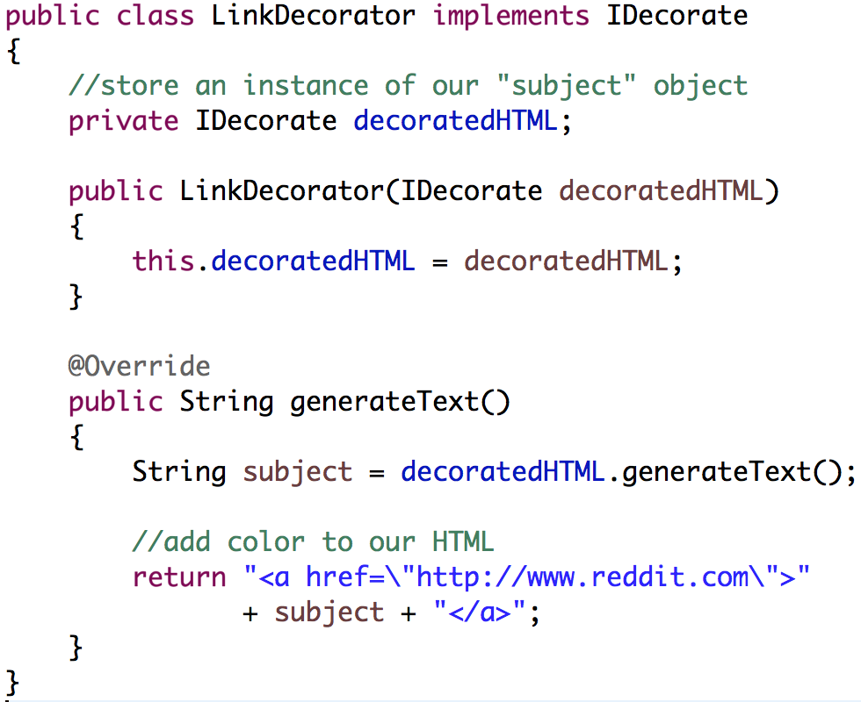
Layering decorators

Slide 12
Layered decorators
LinkDecorator
ColorDecorator
HTMLText
Hello World!
IDecorate html = new LinkDecorator(
new ColorDecorator(
new HTMLText(“Hello World!”)));
html.generateText();

Slide 13
Layered decorators
LinkDecorator
ColorDecorator
HTMLText
Hello World!
Sequence of method calls
LinkDecorator.generateText()
ColorDecorator.generateText()
HTMLText.generateText()

Slide 14
Layered decorators
LinkDecorator
ColorDecorator
HTMLText
Hello World!
Result after HTMLText.generateText()
“Hello World!”

Slide 15
Layered decorators
LinkDecorator
ColorDecorator
HTMLText
Hello World!
Result after ColorDecorator.generateText()
<span style=“color: #FFCC66>Hello World</span>

Slide 16
Layered decorators
LinkDecorator
ColorDecorator
HTMLText
Hello World!
Result after LinkDecorator.generateText()
<a href=“”><span style=“color: #FFCC66>Hello World</span></a>

Slide 17
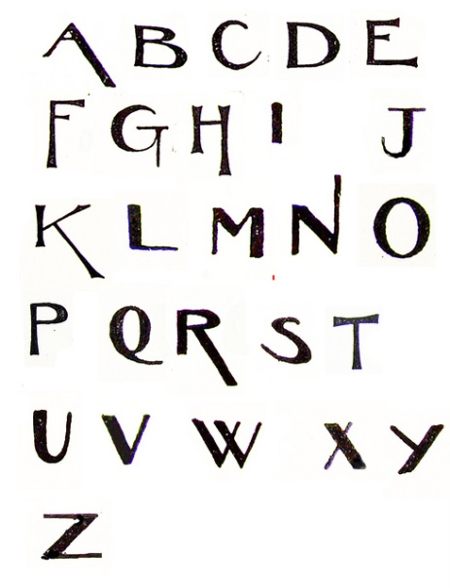
Some things to think about
How would you write a prepend/append decorator?
Never say never!
“Never say never!” - saying
How would you write a Font decorator?
Font family?
Font size?
Font decoration (no pun intended)
How would your write a:
margin/padding decorator?
border decorator?
tooltip decorator?

Slide 18
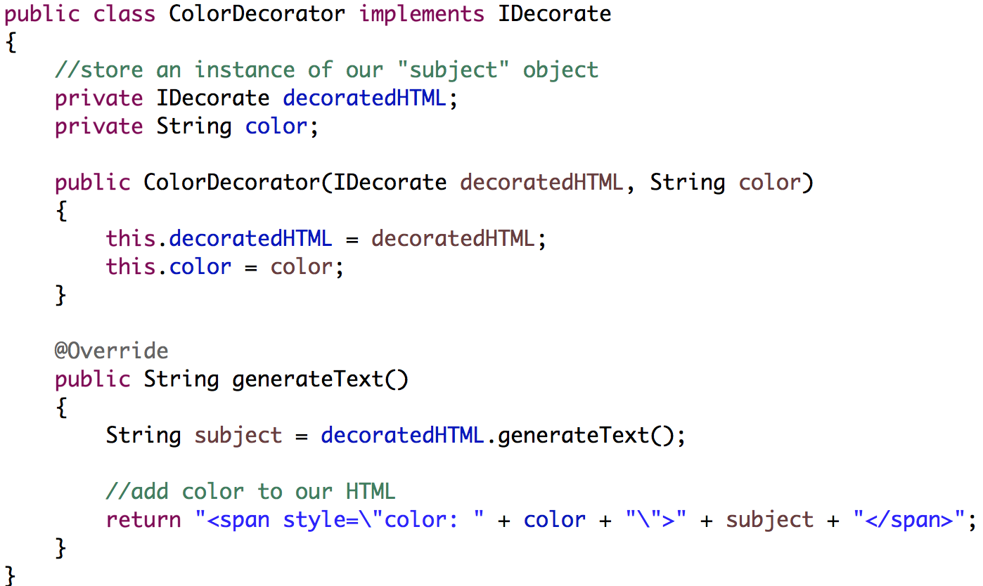
Some things to think about
You will often need to pass extra information to your decorators for them to work correctly
ColorDecorator: a new color (background, foreground)
LinkDecorator: the URL

Slide 19
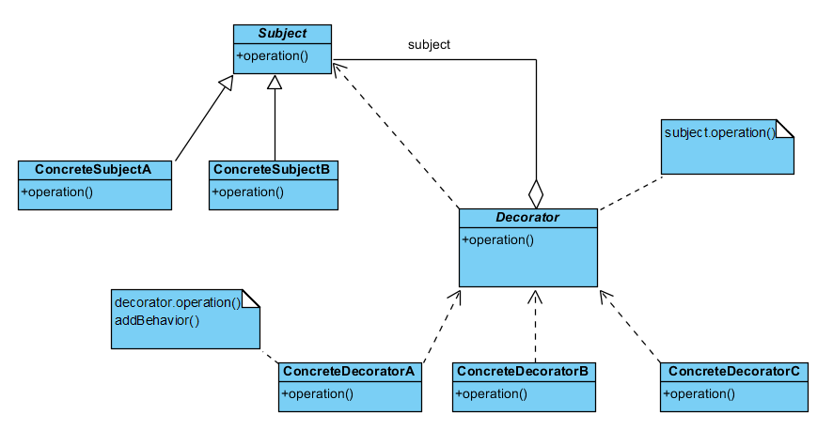
Let’s write some code

Slide 20
Sources
Gamma, Erich, et al. Design Patterns: Elements of Reusable Object-Oriented Software. Indianapolis, IN: Addison-Wesley, 1994

Slide 21
Design Patterns
The Decorator Pattern
IT 426

